Slide 1





Medical Imaging Analysis
Team : NAVEEN CLITON A Guide: P.RAJA
naveencliton9138@gmail.com (Master trainer edunet foundation)
912421114305
0201CE2AC18774CA5F64FF334CE05F43 (aut2291240008)
Disclaimer: The content is curated for educational purposes only.
Notes:
Slides: Prepare a short slide deck (10-12 slides) summarizing the project objectives, methodology, and key results.

Slide 2
OUTLINE
Abstract of the Project
Problem Statement
Proposed Solution
System Architecture
Live Demo of the Project
Conclusion
Future Scope

Slide 3
Abstract
The application of AI in medical imaging analysis has revolutionized the field of radiology by enabling automated diagnosis and improved interpretation of medical images such as X-rays, MRIs, and CT scans. This technology is utilized by leading healthcare companies to enhance diagnostic accuracy, streamline workflows, and prioritize critical cases. Despite its significant potential, challenges remain in terms of data quality, biases, and integrating diverse data sources for comprehensive analysis. Future research aims to address these limitations by incorporating advanced machine learning techniques, longitudinal studies, and additional data such as genetic and treatment information to further improve patient outcomes and the precision of medical imaging.

Slide 4
Problem Statement
The objective of the Medical Imaging Analysis project is to develop advanced AI models that automate the diagnosis and analysis of medical images, such as X-rays and MRIs. These models aim to accurately detect abnormalities, thereby enhancing the diagnostic capabilities of radiologists and facilitating more efficient interpretations. By leveraging machine learning and deep learning techniques, this project seeks to improve diagnostic accuracy, reduce processing time, and support clinical decision-making, ultimately leading to better patient outcomes and streamlined healthcare delivery.

Slide 5
Proposed Solution
The proposed solution involves developing an AI-based system for automated medical imaging analysis to assist radiologists in diagnosing and interpreting medical images more accurately and efficiently.

Slide 6
System Architecture
Data Acquisition Layer
Data Storage Layer
Preprocessing Layer
Feature Extraction & Analysis Layer
Visualization Layer
Post-Processing & Decision Support Layer
Security & Privacy Layer
Integration and Communication Layer
Deployment Layer
Feedback & Continuous Improvement

Slide 7
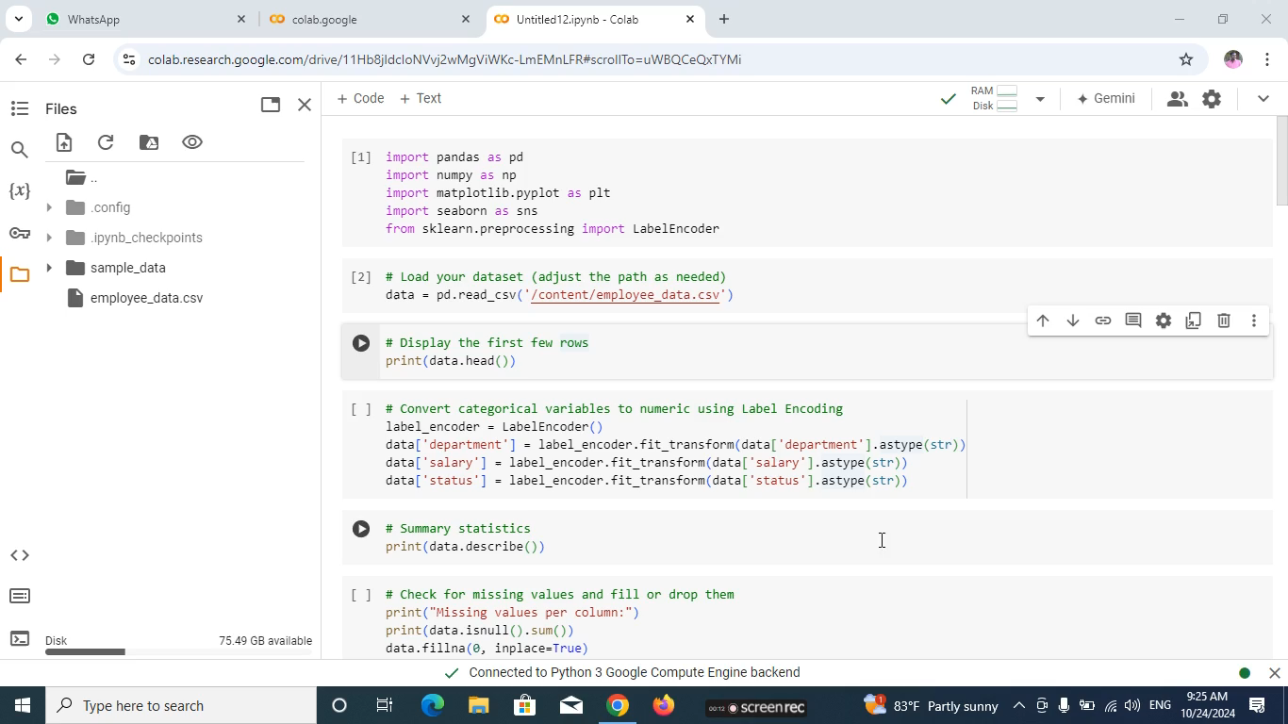
Live Demo of Project
https://drive.google.com/file/d/1wL4UdvxalV9T2nd61B1eNr9mH55mT7_c/view?usp=drive_link

Slide 8
Conclusion
In conclusion, the analysis of the brain tumor dataset provides valuable insights into the distribution and characteristics of various tumor types, sizes, and their demographic associations. The visualizations generated highlight key trends that can inform clinical decision-making and enhance understanding of tumor behavior. Despite certain limitations, such as potential biases and the lack of longitudinal data, the findings serve as a foundation for future research. By leveraging advanced analytical techniques and integrating diverse data sources, we can further improve diagnostic accuracy and patient care. Ultimately, this work underscores the importance of data-driven approaches in the field of medical imaging and oncology.

Slide 9
Future Scope
Future work should focus on conducting longitudinal studies to track tumor progression and patient outcomes over time, providing deeper insights into the dynamics of brain tumors. Integrating additional data sources, such as genetic information and treatment histories, will enhance the analysis and understanding of tumor characteristics and patient responses. Implementing advanced machine learning algorithms for predictive modeling could improve diagnostic accuracy and identify potential risk factors. Additionally, exploring imaging data alongside demographic information will create a more comprehensive model for tumor analysis. Finally, collaboration with medical professionals is essential to validate findings and ensure their practical applicability in clinical settings.

Slide 10
Thank you!
Notes:
thank you very much for joining this PPT, keep learning.
10

